Slide 1
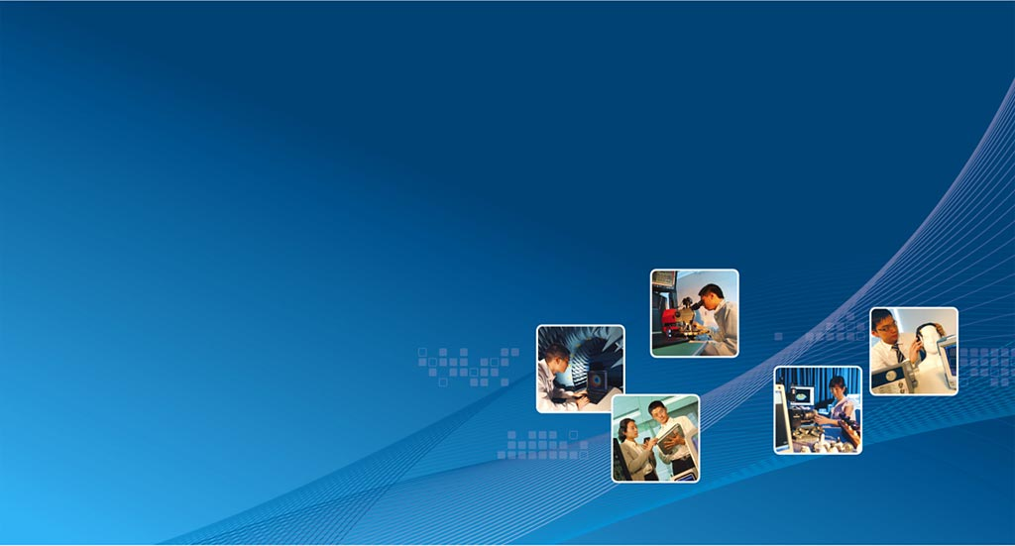

Cross-platform App Tools for Consumer and Enterprise Market
Andy Lam
Deputy R&D Director
Enterprise & Consumer Electronics Group
Apr, 2013

Slide 2
Market trend/3C convergence
PC era - Mobile era - TV era -> 3C got convergence
Common factor: hardware configuration, software stack, connectivity
Shipment (growth in mobile/smart TV, decline in PC):
  2012, the total number of smartphone shipments to retailers worldwide reaches 717 million, 45% more than what was shipped in 2011 (Dec 2012 IDC)
  Sales of connected TV will experience a compound annual growth rate of 30% to reach 123 million units shipped worldwide by the year 2014 (DisplaySearch predicted)
  Worldwide PC shipments totaled 89.8 million units in the fourth quarter of 2012 (4Q12), down 6.4% compared to the same quarter in 2011 (IDC)

Slide 3
Smartphone Market Size
2012, the total number of smartphone shipments to retailers worldwide reaches 717 million, 45 % more than what was shipped in 2011 (Dec 2012 IDC)
Operating System | Q2 2012 Shipments | Q2 2012 Market Share | Q2 2011 Shipments | Q2 2011 Market Share | Year-over-year Change
Android | 104.8 | 68.1% | 50.8 | 46.9% | 106.5%
iOS | 26.0 | 16.9% | 20.4 | 18.8% | 27.5%
BlackBerry OS | 7.4 | 4.8% | 12.5 | 11.5% | -40.9%
Symbian | 6.8 | 4.4% | 18.3 | 16.9% | -62.9%
Windows Phone 7 / Windows Mobile | 5.4 | 3.5% | 2.5 | 2.3% | 115.3%
Linux | 3.5 | 2.3% | 3.3 | 3.0% | 6.3%
Others | 0.1 | 0.1% | 0.6 | 0.5% | -80.0%
Grand Total | 154.0 | 100.0% | 108.3 | 100.0% | 42.2%
Top Smartphone Operating Systems, Shipments, and Market Share, Q2 2012 (Units in Millions)
IDC Worldwide Mobile Phone Tracker, August 8, 2012

Slide 4
Tablet PC Market Size
Worldwide Sales of Media Tablets to End Users by OS (Thousands of Units)
OS | 2010 | 2011 | 2012 | 2015
Android | 2,512 | 11,020 | 22,875 | 116,444
iOS | 14,685 | 46,697 | 69,025 | 148,674
MeeGo | 179 | 476 | 490 | 197
Microsoft | 0 | 0 | 4,348 | 34,435
QNX | 0 | 3,016 | 6,274 | 26,123
WebOS | 0 | 2,053 | 0 | 0
Other Operating Systems | 235 | 375 | 467 | 431
Total Market | 17,610 | 63,637 | 103,479 | 326,304
Gartner (September 2011)

Slide 5
Worldwide PC Vendor Unit Shipmen for 2Q
Company | 2Q12 Shipments | 2Q12 Market Share (%) | 2Q11 Shipments | 2Q11 Market Share (%) | 2Q12-2Q11 Growth (%)
HP | 13,036,548 | 14.9 | 14,838,734 | 16.9 | -12.1
Lenovo | 12,820,301 | 14.7 | 11,160,303 | 12.7 | 14.9
Acer Group | 9,646,383 | 11.0 | 9,315,341 | 10.6 | 3.6
Dell | 9,349,212 | 10.7 | 10,570,007 | 12.1 | -11.5
ASUS | 6,120,957 | 7.0 | 4,416,125 | 5.0 | 38.6
Others | 36,495,872 | 41.7 | 37,256,607 | 42.6 | -2.0
Total | 87,469,273 | 100.0 | 87,557,116 | 100.0 | -0.1
Data includes desk-based PCs and Notebook PCs, including mini-notebooks, Exclude media tablets such as the iPad. Source: Gartner (July 2012)

Slide 6
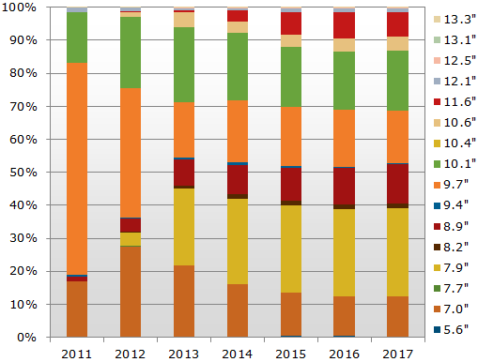
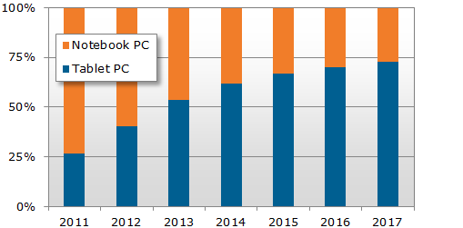
Tablet PC vs Note Book PC
2013:Tablet PCs
7-8" :45% share
9.7" :17% share
2013:
Tablet PCs : 240 million units
Note Book PCs: 207 million units.
207m
240m
NPD DisplaySearch Reports, SANTA CLARA, CALIF., January 7, 2013

Slide 7
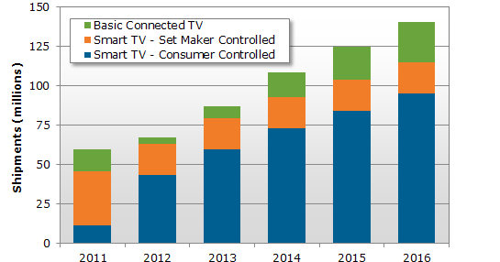
Smart TV Market Size
NPD DisplaySearch SANTA CLARA, CALIF., October 17, 2012

Slide 8
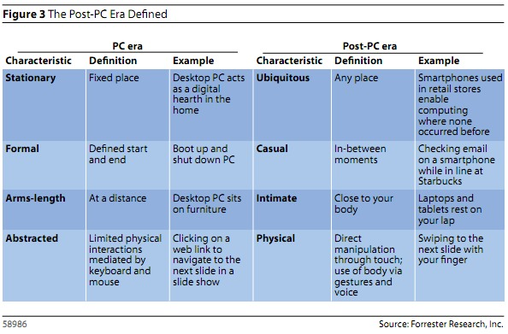
Post-PC era

Slide 9
Typical Application (Apps) Development
Code development
N platforms, N development cycles
N x $$$
N x development time or N x developers
Major mobile platforms:
  Android, IOS, BlackBerry etc.
Major desktop platforms:
  Windows, MacOS, Linux (Ubuntu/Debian) etc.
Any success for cross-platform development?
  Yes or no, e.g. desktop is successful
How about Web/HTML?
  In certain applications, yes.
  However, there are a lot of limitations: it can’t provide like good user experience, game type apps, public server etc.
Apps Build
x N
Platform Debug
&Testing

Slide 10
Cross Application (Apps) Development
Code development
x 1
Single code base development, N times of build and testing
N x $$$ -> 1 x $$$
N x (development time or developers) -> 1
Enhance market penetration rate with quick prototype time
Developers can focus on their domain rather than spend time on platform
Apps Build
<x N
Platform Debug
&Testing

Slide 11
Technical Challenges
Programming languages
  Android - Java
  IOS & MacOS - Obj-C
  Windows - C#
  Linux - C/C++
  Web - JavaScript
Platform API
  The Platform API is very different in performing similar actions
  e.g. extract sensor info, drawing UI widgets
Application nature
  Application life cycle
  Application handling (background service, foreground UI etc.)
Development Environment
  development, debug and testing have different environment requirements
  different tools dependencies or even OS

Slide 12
How to cross platforms?
1. Static Language on Compiler Technology
Single Code Base
Engine
(Static Compiler)
Platform Specific
Code Base
Platforms
2. Static Language on Virtual Machine/Interpreter Technology
Single Code Base
Engine
(Static VM)
Platforms
3. Web based (JavaScript/HTML) Technology
Single Code Base
Engine
(Browser)
Platforms
4. Dynamic Language on Virtual Machine/Interpreter Technology
Single Code Base
Engine
(Dynamic VM)
Platforms

Slide 13
Pro & cons for various cross technologies
 | Pros | Cons
1. Static Language on Compiler (e.g. LLVM) | Powerful and fast | Difficult to develop a good compiler for bind with various platform Lack of third party library (no batteries included)
2. Static Language on Virtual Machine/Interpreter (e.g. Java) | Already in the market and deployed on Android Large third party library support (but no repository) | iOS does not allow Just-in-time optimization
3. Web based (JavaScript/HTML) (e.g. PhoneGap) | Easy to do with local Html or build-in web server | Limitation on Javascript Inferior user experience Hard for graphically demanding application (games)
4. Dynamic Language on Virtual Machine/Interpreter (e.g. Kivy) | Technology proven in desktop already Large repository of third party library Fast prototyping Compiled to native binary before deployment (superior than JIT) Support games through OpenGL API Can combine with Web/HTML technology Easy to do with local Html or build-in web server | No existing solution can support all the potential features

Slide 14
Dynamic Language for cross platforms
Why dynamic language?
  Platform independent
  Fast prototyping
  Rich third party libraries through central repository
  More abstract and higher level, easier to learn
Current application
  Server/Web development already use this kind of programming languages (PHP, Python, Ruby)
  But it is rare in the embedded systems
Why now?
  Adaptation of the powerful CPU (multi-core) on mobile,
  Dynamic programming is feasible
  Not much performance difference from the user point of view
  Platform owner want proprietary code base
  Native compilation for crucial components
  Blends the advantages of static compiler, dynamic language and Web based technologies

Slide 15
Language Performances
C – 1x
C++ - 2x
Java – 2-3x
Python, Ruby, Javascript – 2-5x
CPU times only, no memory comparison (which is available)
Fibonacci (for fun, no real application)
http://fengmk2.github.io/blog/2011/fibonacci/nodejs-python-php-ruby-lua.html
C 1x, Java6 6x, nodejs0.8.8 14x, Ruby2.0 135x, Python2.7 389x
Math related test, taking “median” on “x86 one core” against “C gcc”
http://benchmarksgame.alioth.debian.org/
C 1x, C++ 1x, Java7 1x, v8 3x, Ruby2.0 48x, JRuby/Java7 28x, Python3 46x
String manipulation with Regex (C/C++ use "moving window" substitution, sub-par Java implementation)
C 1x, C++ 3x, Java6 25x, v8 3x, Ruby 4x, Python2.5 4x, Python3 11x
Need summarize

Slide 16
Existing Related Market Technologies
Need summarize
PhoneGap
  Browser runtime + PhoneGap native Device API
  ✔ HTML front end
Titanium
  Titanium runtime (native UI +
  Rhino->Java bytecode on Android / JSCore interpreter on iOS)
  Not using WebView
    ✔ Faster, lesser footprint
    ✘ Different UI widget API on different platforms)
  ✘ DO have OpenGL ES module (need pro subscription => $$$)
  ✘ Insufficient Device API support
  ✔ Test on desktop before deployment
Kivy
  Kivy runtime (native UI over OpenGL ES + CPython interpreter / compiled C code)
  ✔ Clean abstraction layer (native compiler, OpenGL ES, media, wrapper from platform language to Python)
  ✔ Test on desktop before deployment
  ✔ Easily port time critical component to native code
  ✘ Does not support HTML front end

Slide 17
ASTRI Solution
Python based solution
Pros – support Game (consumer), Web (consumer & enterprise)
GAME
WEB
Browser
Game Logic
Web frontend
Python
Runtime
OpenGL ES
Web Server
Business Logic
Media

Slide 18
Deliverables
Prototypes

Slide 19
Project Schedule (need modified)
2012
2013
2014
Sep
Nov
Jan
Feb
Apr
Jun
Aug
Oct
Dec
Feb
Apr
Sep
Nov
Jan
Feb
Apr
Jun
Aug
Oct
Dec
Feb
Apr
Business & Partnership Development
Android platform with privacy protection technology
Feasibility on
Architecture,
Requirement etc.
Software
Development
Verification on various threats
Reference Design ready
Ready for
Production
Privacy Sentinel
Quarantine House
Patent Filling
Office actions
IP research on threat detect algorithm and OAuth extension

Slide 20
Funding Requirement (need modified)
Funding Requirements (18 Months)
  Manpower (6 engineers ) $5.2 M
  Equipment $0.5 M
  Other Direct Cost $2.2 M
    Patent Filling $1.0M
    University Collaboration $1.0M
    Audit …
    Travel …
    Other …………
Total $7.9M
ITF Request: $7.1M

Slide 21

End of Presentation
Thank you. Do you have any questions?
Our corporate website: www.astri.org

Slide 22
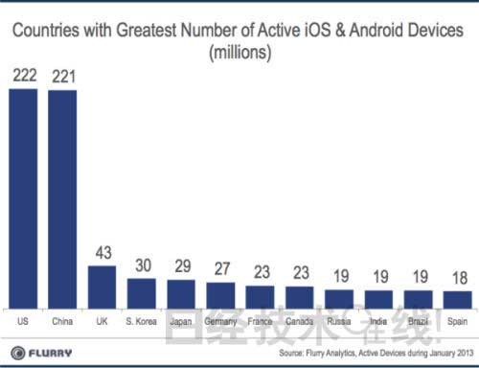
Smart CE Market Size per Countries

